Slide 1
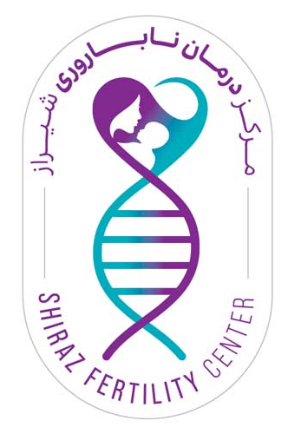
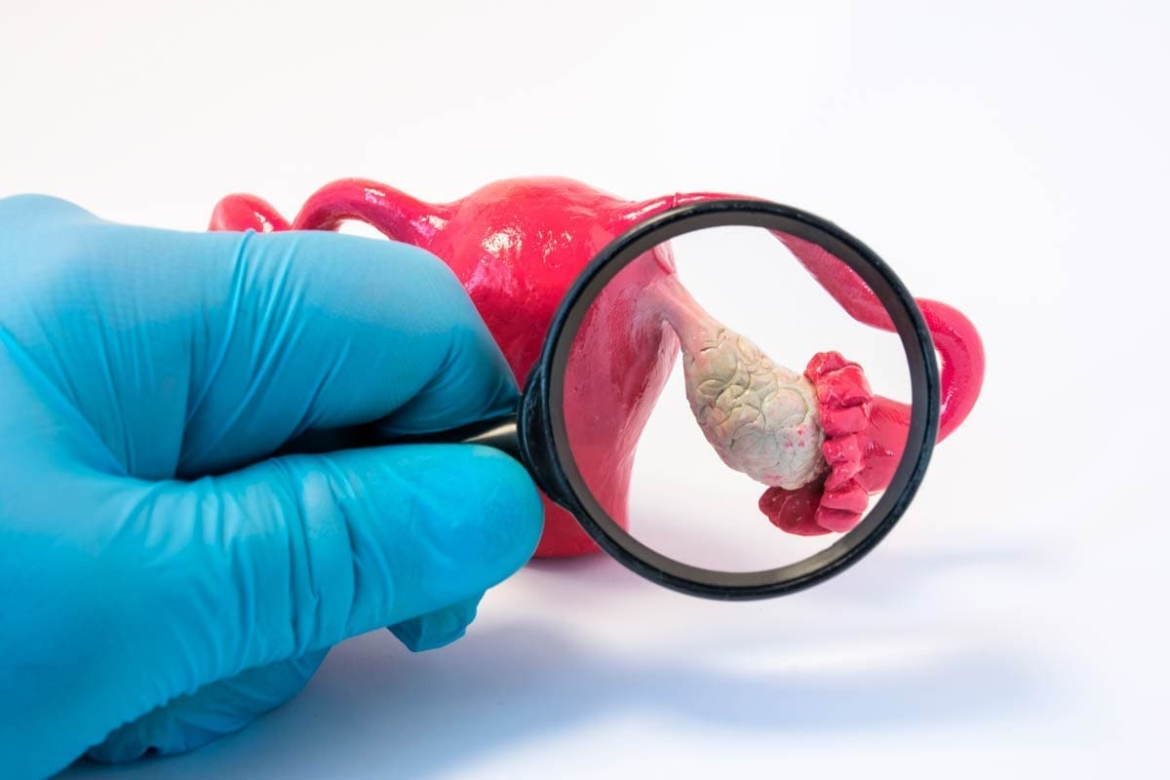
Medical management in POI
Dr. Sirus Rostami

Slide 2
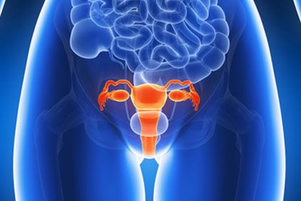
INTRODUCTION
Premature ovarian insufficiency (POI) is characterized by deficient ovarian sex hormones and decreased ovarian reserve, which together lead to an accelerated reduction in ovarian function and an early onset of menopause.
This condition often results in subfertility or infertility, as it is associated with hypoestrogenism, which causes menstrual irregularities and pregnancy failures
Although this condition was previously referred to as premature ovarian failure (POF), some patients are known to have residual ovarian function that seldom leads to pregnancy.
Therefore, the term POI was adopted by an American consensus meeting and by the European Society of Human Reproduction and Embryology (ESHRE) consensus.

Slide 3
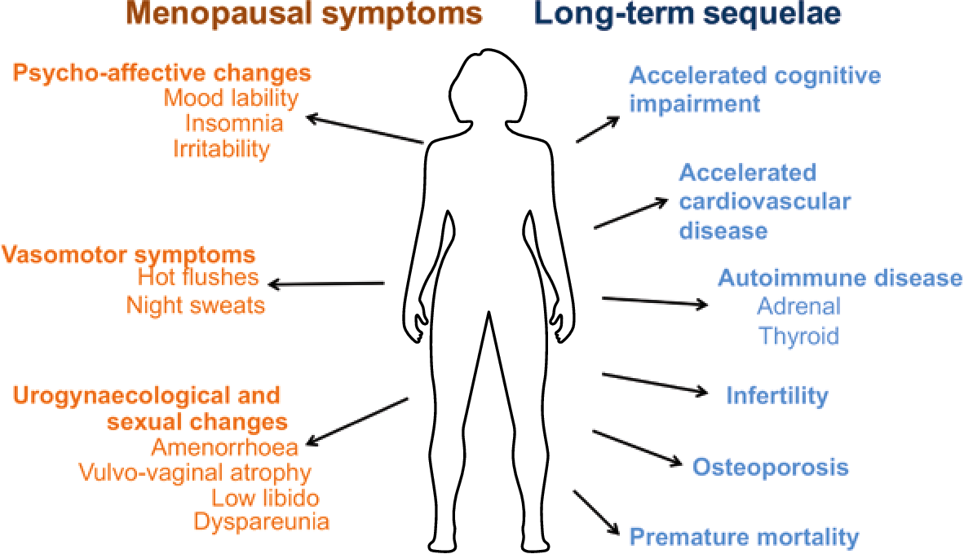
Symptoms of POI
The decrease in estrogen secretion causes:
  Menopausal symptoms:
    Hot flashes, Night sweats, and insomnia
  long-term consequences:
    Risk of skeletal fragility
    cardiovascular and neurocognitive disorders

Slide 4
Incidence
POI occurs in approximately 1% of the women who have not reached 40 years of age.
Epidemiological studies have shown that POI incidence also depends on ethnicity.
The estimated incidence rate ratio varies with age;
  1:100 cases by the age of 40 years
  1:250 cases at the age of 35 years
  1:1000 cases by 30 years
  1:10,000 cases during the age of 18–25 years.

Slide 5
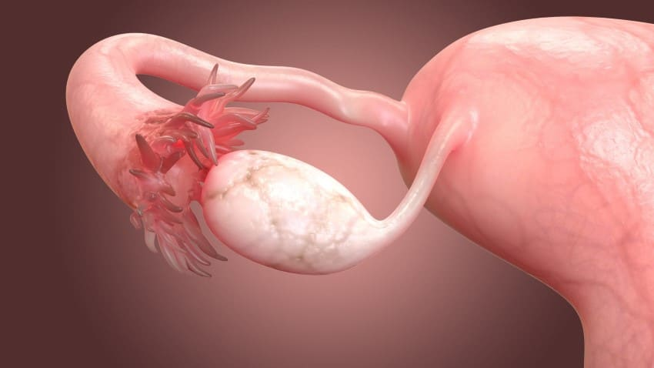
Diagnosis of POI
POI is diagnosed when a woman presents:
  Amenorrhea before 40 years of age
  An elevated serum level of pituitary gonadotropin follicle-stimulating hormone (FSH)
  Low levels of estradiol (E2).
Serum levels of FSH and E2 are measured on at least two separate occasions with more than 4 weeks of interval, and patients that present with continuously elevated FSH levels (greater than 25 IU/L) are diagnosed with POI.

Slide 6
Folliculogenesis and ovulation in normal ovary versus POI ovary

Slide 7
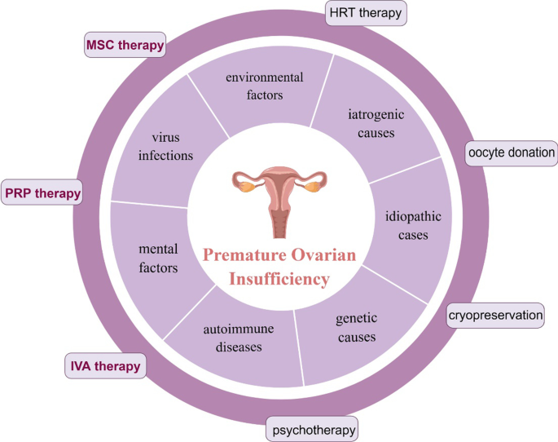
Causes and possible treatment in POI

Slide 8
Treatment option in POI

Slide 9
HRT in POI
Appropriate physiological estrogen/progestin therapy is regarded as the conventional management of POI, as it ameliorates the health complications resulting from this condition, such as menopause-associated symptoms, loss of bone mineral density, fractures, dry eye syndrome
Hormone replacement therapy (HRT) involves the prescription of hormones to replace those that normally would be present but are deficient.
HRTs include the administration of bioidentical and non-bioidentical estrogens and progestins such as levonorgestrel and progesterone, as well as compounding for women who require multiple hormones.

Slide 10
Suggested estrogen regimens
Theoretically, hormone replacement for young women with POI should mimic normal ovarian function as much as possible.
Estradiol (17-beta-estradiol; E2) and micronized progesterone are bioidentical hormones, eg, they have the same molecular structure as the estradiol and progesterone produced by the ovary.
Optimal replacement with sex steroids depends on whether the patient presents with primary or secondary amenorrhea.

Slide 11
Primary amenorrhea:
Girls or young women with primary amenorrhea in whom secondary sex characteristics have not developed should initially be given very low doses of estradiol (at first without a progestin) in an attempt to mimic gradual pubertal maturation
Secondary amenorrhea
Most women present with secondary amenorrhea. We initiate full replacement doses of estrogen with oral estradiol (2 mg/day) or transdermal estradiol (100 mcg patch). An estradiol vaginal ring (100 mcg daily) is another option. This dose is higher than what is used for postmenopausal females and is based on the average daily production of estradiol by the premenopausal ovary.

Slide 12
Choice of progestin
Most women with POI will have an intact uterus and require progestin to prevent estrogen-induced endometrial hyperplasia and carcinoma.
Our first-line progestin is micronized progesterone (MP) 200 mg per day for the first 12 days of the month.
Medroxyprogesterone acetate (MPA) is used by some clinicians. For MPA, endometrial safety data come from one trial in women with POI and trials in postmenopausal women. For MP, there is indirect evidence of endometrial protection from multiple trials in postmenopausal women.
For women who are unable to tolerate standard progestins, another option is estradiol therapy combined with a levonorgestrel-releasing intrauterine device (IUD).
For women who desire treatment for estrogen deficiency symptoms, but want to maintain the possibility of a spontaneous conception, only micronized progesterone should be used

Slide 13
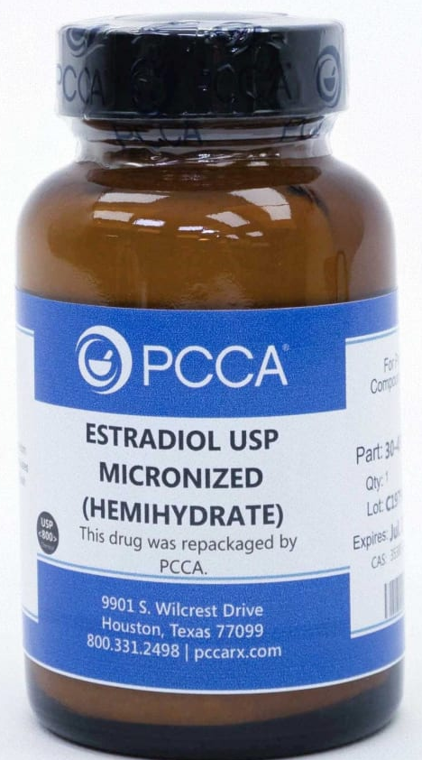
Estrogen
Estrogen deficiency is the primary ovarian hormone deficiency in women with POI. Therefore, unless estrogen-based hormone therapy is contraindicated, estrogen treatment is required to replace the depleted estrogen.
Physiological estrogen levels can be achieved with oral (micronized estradiol 1–2 mg daily or conjugated equine estrogens 0.625–1.25 mg daily) or transdermal estrogen regimens (0.1 mg daily).

Slide 14
EspEstrogen substitution therapy in adolescencey in adolescence

Slide 15
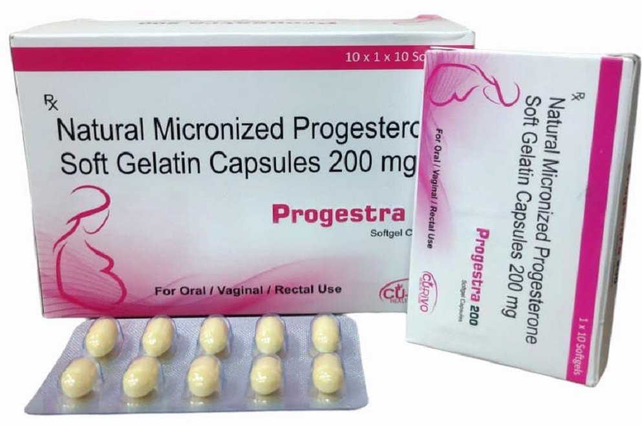
Progesterone
Moreover, additive continuous or cyclic progesterone is required if women have a uterus to protect their endometrium.
For cyclic therapy, a progestogen (micronized progesterone 200 mg daily or medroxyprogesterone acetate 10 mg daily for 12–14 days in a month) could be administered additively if the patient is pursuing pregnancy

Slide 16
Spontaneous ovulation
In ultrasound studies of women with POI, follicular development occurs frequently, with evidence of follicle luteinization in many cases.
Ovulation is infrequent, with approximately a 4 percent chance per month. Small studies suggest frequent monitoring (every two to four weeks) for spontaneous follicle growth by ultrasound may provide an opportunity for a spontaneous conception. Such an approach may also help provide closure should there be no ovarian activity documented in a three- to six-month timeframe.

Slide 17
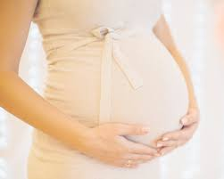
Pregnancy in POI
Spontaneous pregnancies are extremely scarce in patients with POI.
Women experiencing POI have menstrual irregularities that hinder their fertility.
Some patients with idiopathic POI present an intermittent ovarian function and hence, their chance of conceiving spontaneously and having an uneventful pregnancy course is approximately 5%.
Among the 25% of POI patients who can ovulate, only 5–10% can conceive.
Oocyte donation is the recommended treatment for infertility due to POI, as it has been proven to achieve a 70–80% successful pregnancy rate.

Slide 18
Ineffective or unproven medical therapies
Clomiphene citrate and letrozole:
An anti-estrogenic agent such as clomiphene citrate and the aromatase inhibitor letrozole have not been studied in this population, but they are unlikely to be effective in hypoestrogenic women.
Gonadotropin therapy:
Exogenous gonadotropin therapy has been studied as a potential strategy to improve ovulatory rates in women with POI, but it is ineffective. Exogenous gonadotropins could theoretically exacerbate unrecognized autoimmune ovarian failure

Slide 19
Gonadotropin therapy:
Suppression of endogenous gonadotropin concentrations with pharmacologic doses of estrogen before gonadotropin therapy has been reported to improve ovulatory rates in some, but not all, studies.
In the one randomized, placebo-controlled trial available, treatment with 150 mcg ethinyl estradiol/day for two weeks before and during stimulation with recombinant follicle-stimulating hormone (FSH), ovulatory rates were significantly higher in the estrogen group (32 percent, 8 of 25 women) when compared with the placebo group (0 of 25 ovulated). Ovulation only occurred in women whose serum FSH concentrations were suppressed to ≤15 international units/L with estrogen. It is possible the improved ovulation rates in this study were related to suppression of luteinizing hormone (LH) levels and avoidance of inappropriate follicle luteinization.
Suppression of endogenous gonadotropin concentrations with a gonadotropin-releasing hormone (GnRH) agonist before gonadotropin therapy does not appear to improve ovulatory rates

Slide 20
Glucocorticoid therapy
Glucocorticoid therapy for the treatment of suspected autoimmune ovarian failure, also unproven, carries the risk of iatrogenic Cushing syndrome and osteonecrosis of the hip requiring joint replacement

Slide 21
Contraception
Women with POI should be informed that estradiol/progesterone replacement therapy regimens do not provide effective contraception. Therefore, since spontaneous ovarian activity may resume, contraception is required for those who are not pursuing pregnancy. Women who are concerned about the possibility of spontaneous ovulation and pregnancy can choose hormonal contraception or a barrier method of contraception
ACOG suggests combined oral estrogen-progestin contraceptives. Other contraceptive options include lower, non-contraceptive doses of estradiol (to treat estrogen deficiency symptoms and provide protection against future disease) combined with a levonorgestrel intrauterine contraceptive device (IUD) or oral norethindrone 0.35 mg/day (a contraceptive dose of progestin)

Slide 22
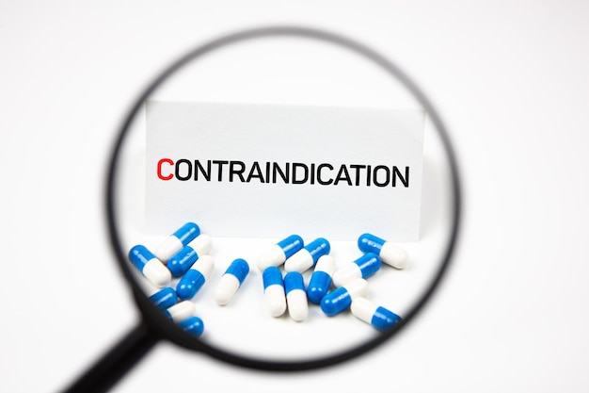
HRT contraindication
HRT use is not recommended in women with:
  A history of breast and ovarian cancer
  In breast-feeding mothers (as it can cause neonatal jaundice and neonatal breast enlargement)
  In patients that have reached the age of 50 years

Slide 23


